Slide 1
Unit C Essential Synthesis

Slide 2
Remember: Data Collection Matters!
Was the explanatory variable randomly assigned?
Was the sample randomly selected?
Yes
No
Yes
No
Possible to generalize to the population
Should not generalize to the population
Possible to make conclusions about causality
Can not make conclusions about causality

Slide 3
Remember: Data Visualization Matters!
Variable(s) | Visualization | Summary Statistics
Categorical | bar chart, pie chart | frequency table, relative frequency table, proportion
Quantitative | dotplot, histogram, boxplot | mean, median, max, min, standard deviation, z-score, range, IQR, five number summary
Categorical vs Categorical | side-by-side bar chart, segmented bar chart | two-way table, difference in proportions
Quantitative vs Categorical | side-by-side boxplots | statistics by group, difference in means
Quantitative vs Quantitative | scatterplot | correlation, simple linear regression

Slide 4
Confidence Interval
A confidence interval for a parameter is an interval computed from sample data by a method that will capture the parameter for a specified proportion of all samples
We have some level of confidence that the population parameter is contained within the confidence interval.

Slide 5
Confidence Interval
When finding a confidence interval for a single parameter (or difference in two parameters) using a normal or t-distribution:
$$Sample Statistic ±\left(z^{∗} or t^{∗}\right) ×SE$$

Slide 6
Confidence Intervals
Return to original scale with

Slide 7
Hypothesis Testing
How unusual would it be to get results as extreme (or more extreme) than those observed, if the null hypothesis is true?
If it would be very unusual, then the null hypothesis is probably not true!
If it would not be very unusual, then there is not evidence against the null hypothesis

Slide 8
p-value
The p-value is the probability of getting a statistic as extreme (or more extreme) as that observed, just by random chance, if the null hypothesis is true
The p-value measures evidence against the null hypothesis

Slide 9
Hypothesis Testing
State hypotheses
Calculate a test statistic, based on your sample data
Use the test statistic to find a p-value using a standard normal or t-distribution
State the conclusion in context

Slide 10
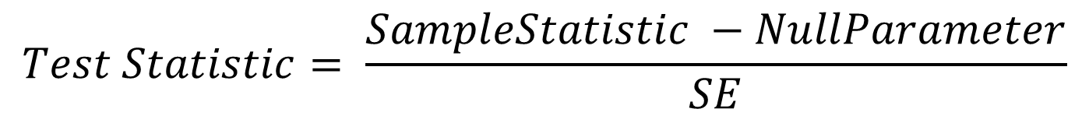
Hypothesis Tests
When conducting a hypothesis test for a single parameter (or difference in two parameters) using a normal or t-distribution:
$$Test Statistic= \frac{SampleStatistic −NullParameter}{SE}$$

Slide 11
Hypothesis Testing

Slide 12
Appropriate Distribution
For proportions (categorical variables), the normal distribution is used
For means (quantitative variables), the t distribution is used

Slide 13
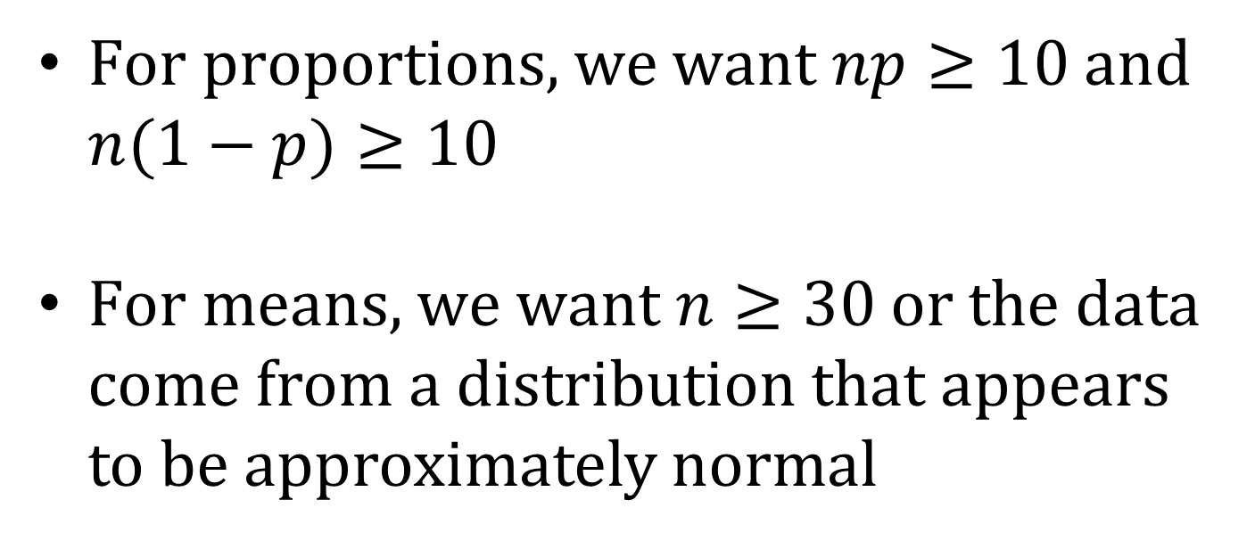
Sample Size Conditions
For proportions, we want $np≥10$ and $n(1−p)≥10$
For means, we want $n≥30$ or the data come from a distribution that appears to be approximately normal

Slide 14
Standard Error
The standard error SE is the standard deviation of the sample statistic
The formula for the standard error depends on the type of statistic (which depends on the type of variable(s) being analyzed)

Slide 15
pg 470
Parameter | Distribution | Conditions | Standard Error
Proportion | Normal | All counts at least 10 np ≥ 10, n(1 – p) ≥ 10
Difference in Proportions | Normal | All counts at least 10 n₁p₁ ≥ 10, n₁(1 – p₁) ≥ 10, n₂p₂ ≥ 10, n₂(1 – p₂) ≥ 10
Mean | t, df = n – 1 | n ≥ 30 or data normal
Difference in Means | t, df = smaller of n₁ – 1, n₂ – 1 | n₁ ≥ 30 or data normal, n₂ ≥ 30 or data normal
Paired Diff. in Means | t, df = n_{d} – 1 | n_{d} ≥ 30 or data normal
Correlation | t, df = n – 2 | n ≥ 30

Slide 16
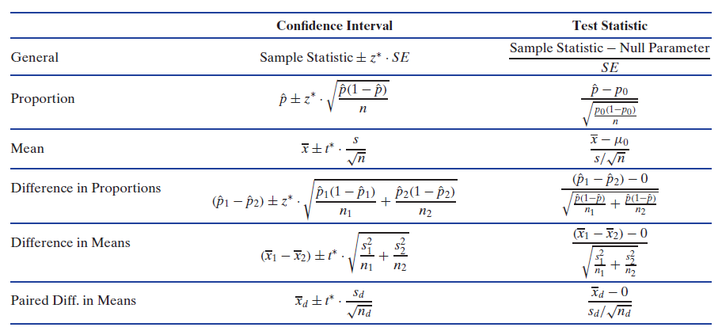
Formulas for Intervals and Tests

Slide 17
Spend the rest of class on examples
Suggestions:
Examples from Unit C Essential Synthesis if students don’t read the book
Exercises from Unit C Essential Synthesis

